Slide 1

AGE DETECTION- Using deep learning
By
- ARPITA DESAI

Slide 2

PROBLEM STATEMENT
Deep Learning - Use this dataset to detect age: https://www.kaggle.com/datasets/arashnic/faces-age-detection-dataset. Build two deep models - one from scratch and the other using a pretrained model to obtain embeddings of the given data. Compare the performances.

Slide 3
DATA PRE-PROCESSING
Input Image Resizing
Denoising
Image Normalization
Categorical Encoding
Data Augmentation

Slide 4
IMAGE RESIZING
When dealing with an image processing problem and the input images come in different sizes the resize function is used to resize all input images to a fixed size, in our case we resized input images to 100x100
DENOISING
It is a process to reserve the details of an image while removing the random noise from the image as far as possible
Median denoising is used to remove the noise from the data. The advantage is it preserves edges while removing the noise from our image.

Slide 5
IMAGE NORMALIZATION
Image normalization is a process, often used in the preparation of data sets for artificial intelligence (AI), in which multiple images are put into a common statistical distribution in terms of size and pixel values
CATEGORICAL ENCODING
We encoded the data using categorical encoding for training the model

Slide 6
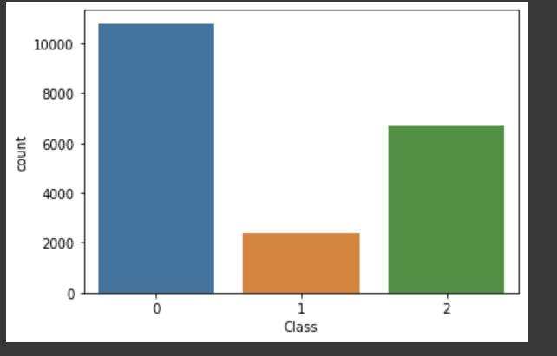
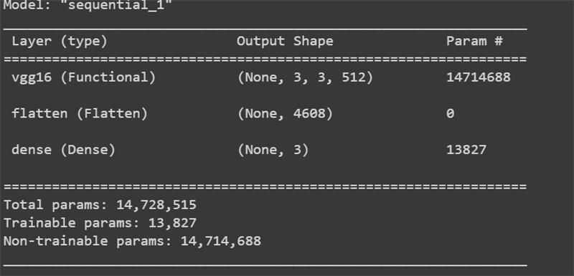
CLASS VISUALIZATION
VGG MODEL

Slide 7
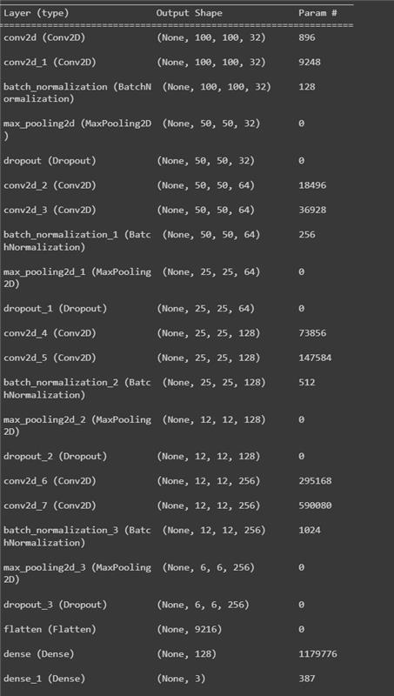
DEEP CNN MODEL

Slide 8
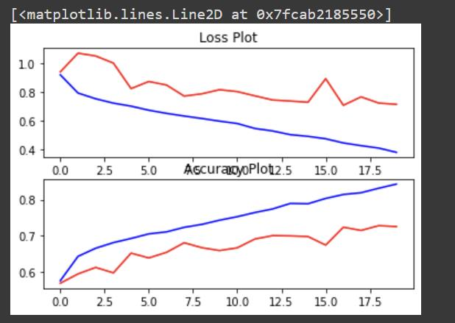
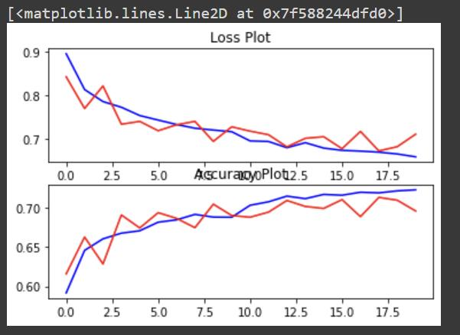
DEEP CNN
VISUALIZATION
vgg
VISUALIZATION

Slide 9
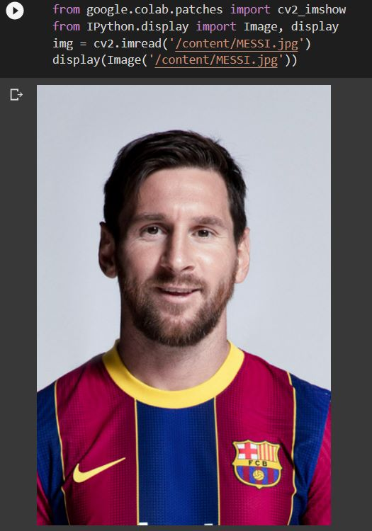
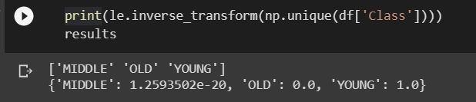
RESULTS

Slide 10
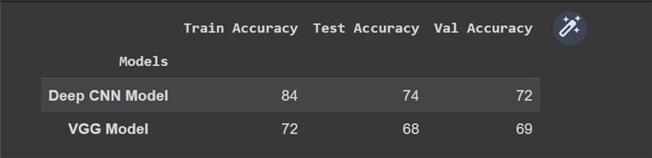
SUMMARY

Slide 11
THANK YOU !!

